Slide 1
A Comparative Study of Spatial, Frequency, and Hybrid Feature Learning for AI Generated Video Detection
By: G. Karthik Yadav, K. Pujyank, M. Sriharshith
Under the supervision of: Dr. V. B. Narsimha Department of CSE, Osmania University

Slide 2
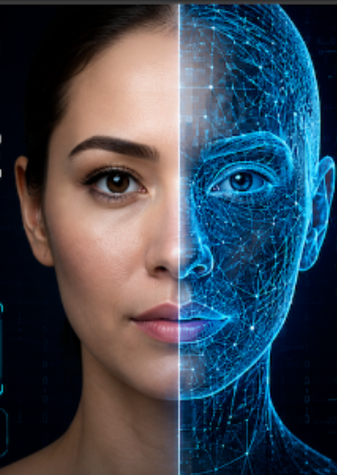
The Problem Statement
■
The rapid development of artificial intelligence like rise of deepfakes and Generative Adversarial Networks (GANs) has enabled the creation of highly realistic synthetic videos, making it increasingly difficult to distinguish AI generated content from authentic videos. Technologies such as deepfakes and generative models can replicate facial expressions, movements, and visual details with remarkable accuracy, creating serious concerns related to cyber security threats and misinformation

Slide 3





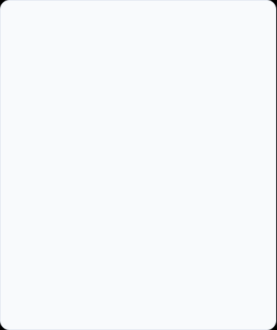
The Problem Statement
Misinformation & Deepfakes
Identity Misuse
False Narratives
Al allows for the creation of explicit content and the execution of digital fraud with
pixel-perfect accuracy, using the likeness of real individuals without their consent. This poses severe
risks to personal privacy, reputation, and financial security.
Synthetic media is being weaponized at scale to construct and propagate false
narratives. This includes fabricated interviews, events, or actions of public figures, undermining trust
in democratic processes and institutions.
High definition diffusion models are now capable of generating
photo realistic images and videos that bypass standard visual checks. These can be used to create convincing fake news, manipulate public opinion, and spread disinformation with unprecedented
reach and speed.

Slide 4



The Three Feature Approaches
1. Plain RGB (Spatial)
2. Plain FFT (Frequency)
3. Hybrid Fusion
Dual-branch architecture that extracts both spatial and frequency features simultaneously, correlating visual glitches with spectral spikes.
Feeds raw pixel information into the model. Focuses on visual artifacts, textures, and color inconsistencies. Susceptible to compression washing out fine details.
Converts frames into frequency domain. Blind to spatial visual content but highly sensitive to repeating grids, upsampling artifacts, and spectral peaks.

Slide 5
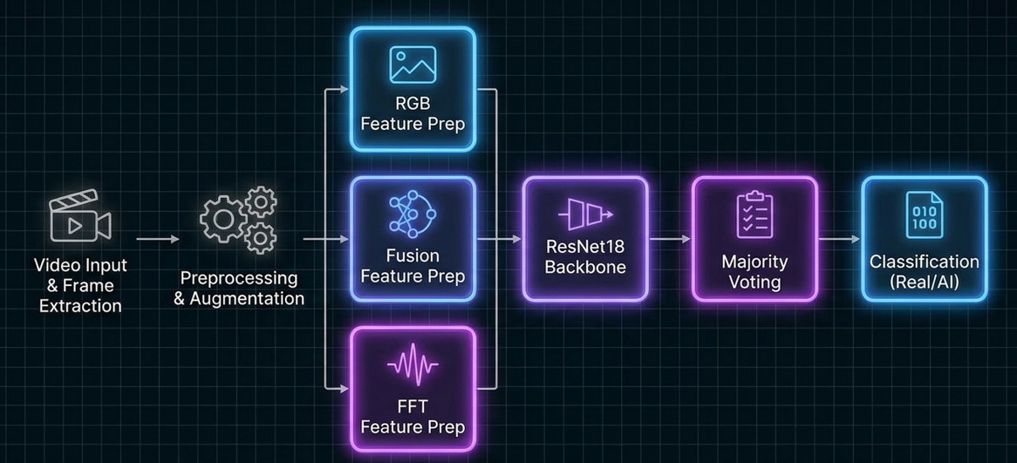
Workflow

Slide 6
Dataset & Preprocessing Strategy
Dataset Collection
Data Augmentation
The dataset consists of exactly 200 videos (100 Real, 100 AI-Generated). Videos were sourced from a wide variety of generators rather than a single source.
To combat the small dataset size and prevent overfitting, aggressive data augmentation was applied only to the training data.
Techniques included: horizontal flipping, small rotations, brightness shifts, blurring, and random erasing to improve real-world generalization.
This diversity forces the model to learn universal indicators of synthetic content rather than memorizing the quirks of one specific AI tool.

Slide 7
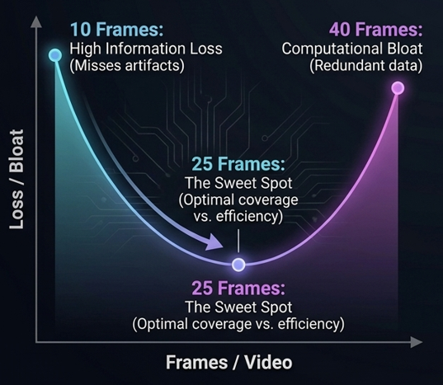
Optimal Frame Extraction
Balancing Data and Computation
Processing every frame of a video is highly computationally expensive. We experimented with extracting 10, 20, 30, and 40 frames per video.
10-20 frames lacked sufficient scene coverage. 40 frames introduced redundancy and increased training time. Extracting exactly 25 frames provided the perfect trade-off between capturing visual content and maintaining computational efficiency.

Slide 8
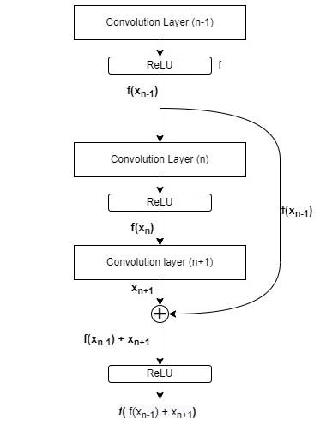
Model Architecture: ResNet18
■
Backbone: Pre-trained ResNet18 (ImageNet weights). Chosen because it is deep enough to catch subtle artifacts but lightweight enough for Google Colab.
■
Convolution layers extract spatial features by sliding learnable filters over the input, going from low-level to high-level features as depth increases
■
Pooling max pooling & global average pooling) downsamples the spatial dimensions and reduces the parameter count before classification.
BatchNorm is applied after each conv layer to normalize activations, stabilizing and speeding up training
Residual Connections: Prevents vanishing gradients, allowing the deep network to train effectively.
■
■

Slide 9
RGB Based Detection
Plain RGB
RGB trained ResNet on FFT
RGB serves as the primary spatial signal, allowing the model to analyze frames in their original camera-captured form. Each frame is resized, normalized, augmented, and passed through a ResNet-18 model with only Layer 4 and the final classification layer fine-tuned to detect AI-generated artifacts. Per-frame predictions are combined using majority voting to produce the final video-level classification.
The RGB model was fine-tuned to learn natural RGB pixel statistics such as color gradients, textures, and intensity patterns. Since FFT magnitude images have a completely different distribution and spatial structure, the model cannot interpret them effectively. As a result, the learned RGB features produce weak and less meaningful activations on frequency-domain inputs, reducing classification performance.

Slide 10

Frequency Domain Analysis (FFT)
Plain FFT
FFT trained ResNet on RGB
FFT converts each frame into its frequency domain representation via FFT, producing a magnitude spectrogram (bright low-frequency center, log-scaled energy values) that's resized,
normalized, and passed through a ResNet 18 backbone trained to detect frequency-domain generative artifacts (periodic upsampling patterns, unnatural spectral decay). Each frame yields its own AI/real prediction based purely on these frequency features, with the video's final label decided by majority vote across sampled frames.
The FFT model's layers were fine-tuned on frequency-domain statistics a bright low-frequency center, log-scaled energy values, and frequency bins instead of pixels. Raw RGB frames carry natural color gradients and pixel intensities roughly in [0,1], a completely different distribution. Feeding RGB into an FFT-trained model means asking it to interpret data it's never seen the filters, tuned for frequency patterns, produce close to meaningless activations on RGB input.

Slide 11
Fusion Architecture (Dual Branch)
RGB + FFT Blend (⍺ = 0.5)
Fusion Model (Dual-Branch)
RGB and FFT magnitude images are combined into a single 3-channel image using a fixed 50:50 blending ratio before being passed through a ResNet-18 model. This allows the network to learn from both spatial textures and frequency patterns simultaneously. Frame-level predictions are combined using majority voting to produce the final video classification.
Instead of blending inputs, the Fusion model processes RGB and FFT images independently using two parallel ResNet-18 backbones. Each branch extracts a 512-dimensional feature vector, which are concatenated into a 1024-dimensional representation and classified using a custom MLP. This feature-level fusion preserves spatial and frequency information, enabling the model to learn complementary patterns more effectively before majority voting determines the final video-level prediction.

Slide 12
Results and Findings
Model Approach | Frame Accuracy | Frame Precision | Video Accuracy | Video Precision
Plain RGB | 83.00% | 84.00% | 87.00% | 87.00%
RGB+FFT Blend (α=0.5) | 87.85% | 89.00% | 90.00% | 93.33%
RGB+FFT Fusion (MLP) | 88.79% | 89.20% | 90.00% | 90.18%
Note: Video-level predictions are derived by applying majority voting across all 25 frames.

Slide 13
Comparative Analysis & Majority Voting
■
Spectral Integration Enhances Detection: Relying solely on spatial data (Plain RGB) is less effective than incorporating frequency domain (FFT) information. By analyzing both spatial features (like color and texture) and spectral cues, models gain access to complementary data, significantly improving their ability to detect subtle artifacts common in AI-generated content.
■
Adaptive Fusion: While the RGB+FFT Blend approach improves accuracy using a fixed weight
(α =0.5) for both domains, the RGB+FFT Fusion model achieves the highest performance by dynamically learning the optimal interaction between features. This adaptive mechanism evaluates each input uniquely, emphasizing the most discriminative spatial and spectral patterns while suppressing less relevant data
Majority Voting Maximizes Robustness :To mitigate the weaknesses of any single architecture, the final system employs an ensemble majority voting strategy. Assuming independent model errors, the ensemble only fails if a majority of the models are simultaneously incorrect on the same image. Formally, where Xi is a Bernoulli random variable indicating a correct classification by model i, the ensemble's success probability is defined as:
■

Slide 14
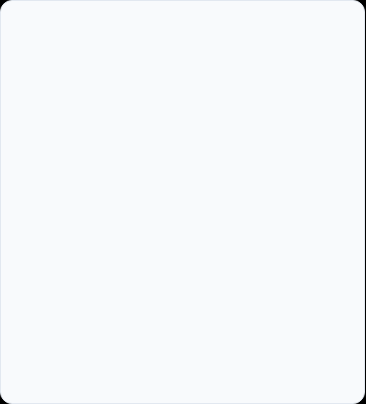


Project Limitations
Dataset & Compute Constraints
Evolving GAN Technology
Trained on only 200 videos. This limits the model's ability to learn universally robust patterns. Google Colab constraints severely restricted batch sizes, parallel model training, and epoch counts, preventing the network from achieving full convergence.
Generative Al evolves at a breakneck pace. Modern, high-end generators leave virtually no visible or spectral artifacts. Despite heavy augmentation, slight overfitting was still observed due to the small dataset and the challenge of keeping up with state-of-the-art synthetic engines.
Future Scope & Enhancements
Temporal Modeling
3D CNN Architectures
Real-World Deployment
Incorporating LSTM or RNN networks to track frame-to-frame motion inconsistencies and blinking irregularities over time.
Transitioning from 2D frame analysis to 3D CNNs to learn spatial and temporal features jointly, providing richer context.
Scaling up the dataset diversity and optimizing the models for real-time
deployment in digital
forensics and moderation environments.

Slide 15
Conclusion
Combining frequency domain analysis with deep learning definitively improves AI-generated video detection over purely spatial methods.
"
— Project Findings
"

Slide 16
Thank You!
Are there any questions?

